Slide 1

Algorithmic Trading
Sreemanta kesh Julia Luz

Slide 2

Table of Contents
INTRODUCTION TO ALGOTRADING
TERMINOLOGIES
THE STRATEGY
BACKTESTING THE STRATEGY

Slide 3

Introduction to Algo-Trading
Normal trading is simply doing trade Manually by trader i.e. Buying & Selling stocks under the supervision of a human.
But there are limits for doing trade manually. Like constantly monitoring charts, human errors, emotional intervention affect strategies, delay in performing actions, etc.
These factors might lead to failure in achieving targets of a trader.
On the other hand, with the help of AlgoTrading, trading process can be automated.
AlgoTrading is a form of Automated trading that uses computer programs to analyze market data based on pre-defined parameters.
Simply, trading will be done by the computers without any delay in action, without any emotions involved or with least errors possible.
Normal Trading
AlgoTrading

Slide 4
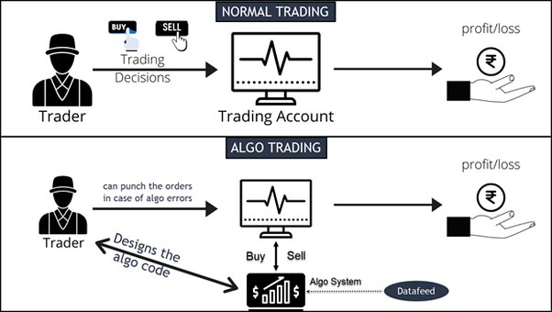
Everything can be automated. No human intervention required.
Trade order placement is instant and accurate.
Reduced risk of manual errors when placing trades.
Algo-trading can be backtested using historical and real-time data to test the strategy.
Reduced the possibility of mistakes by human traders based on emotional and psychological factors.
Benefits of Algo-Trading

Slide 5
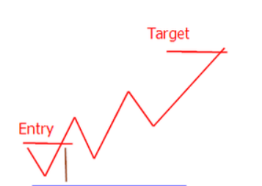
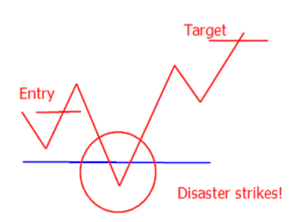
Terminologies
Target is the price at which a trader wishes to exit the trade to get profit.
Assume you bought a share at some price and want to sell it at higher price. That higher price will be the Target price.
As soon as price reaches target price, you should sell to book a profit.
Stop loss as the name indicates, is the price limit which is set to minimize the loss of stakeholder.
Let’s say you bought a share at some price. And the price goes down. When it reaches stoploss price, you should sell.
You’ll be in loss but the loss is reduced using stoploss price.
Target Price
SELL (Profit)
BUY
Stop Loss
SELL (Loss)

Slide 6
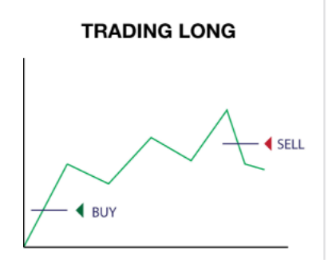
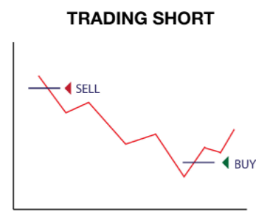
Terminologies
When you expect the price to go up, you BUY the share first.
After reaching either Target or Stoploss you SELL.
This process of Buying first and Selling later is Long Trading.
LONG = BUY
When you expect the price to go down, you SELL the share first.
After reaching either Target or Stoploss you BUY.
This process of Selling first and Buying later is Short Trading.
SHORT = SELL
LONG
SHORT

Slide 7

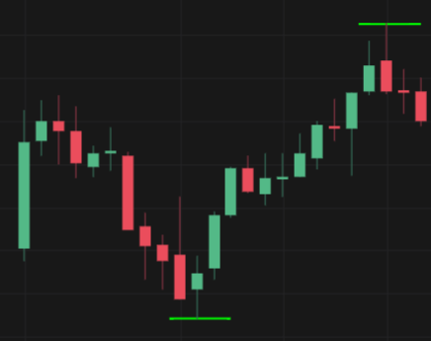
The Strategy
A trading strategy is a fixed plan that is designed to achieve a profitable return by going long or short in market.
Strategy is the most important part in Algo-Trading because the code that will be written is wrote according to the Strategy.
The strategy we will use and code is a simple strategy that depends on interval high & low price.
Check for Interval High & Interval Low at exactly 11 a.m.
Interval high & low are highest & lowest price for specific time interval.
We will not enter the trade as soon as market opens.
We will start trading after 11 a.m.
Step-1 (High & Low)
Interval High
Interval Low
9:15 a.m.
11 a.m.

Slide 8
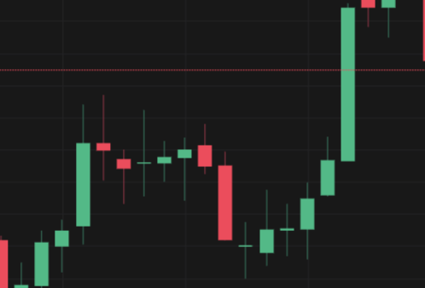
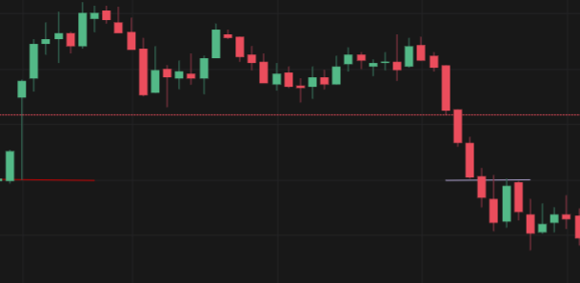
The Strategy
Position = LONG
After defining interval high & interval low, we will wait for the price to either cross the interval high or interval low.
Condition-1
If price crosses the interval high, our position will be LONG
i.e. We will BUY the share and SELL later.
Condition-2
If price crosses the interval low, our position will be SHORT
i.e. We will SELL the share first and BUY later.
Condition-3
If there is no breach in either high or low, we will not enter the trade.
Step-2 (Trade Entry)
Interval High
High crossed
Interval High
Position = SHORT
Low crossed
Interval Low
Interval Low

Slide 9

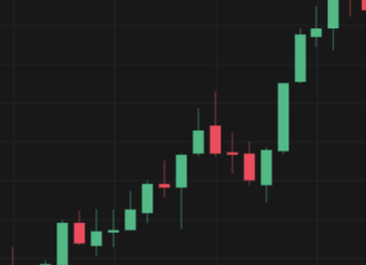
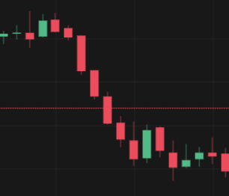
The Strategy
LONG Position :
In case of long trading we need to SELL to exit the trade.
Target price = Interval High + some amount
Stoploss price = Interval High - some amount
After entering trade, we will wait for price to either cross target or stop-loss
If target is crossed, we SELL and book profit. If stop-loss is crossed, we SELL but at loss.
SHORT Position :
In case of short trading we need to BUY to exit the trade.
Target price = Interval Low - some amount
Stoploss price = Interval Low + some amount
If target is crossed, we BUY and book profit. If stop-loss is crossed, we BUY but at loss.
If neither target nor stop-loss is breached, we will exit trade at predefined time
Step-3 (Trade Exit)
PROFIT
Target breach
Trade Entry
Trade Entry
LOSS
Stoploss breach

